Slide 1
CORONAVIRUS DISEASE (COVID-19): Characteristics in children and considerations for Dentists providing their care
Mallineni SK, Innes NP, Raggio DP, Araujo MP, Robertson MD, Jayaraman J. International Journal of Paediatric Dentistry. 2020 May;30(3):245-50.

Slide 2
CONTENTS
INTRODUCTION
COVID-19 –
a. Clinical characteristics of COVID-19 in children
b. The child patient in the dental setting
c. Country-specific approaches & recommendations
d. The role of guidelines and professional judgment
CONCLUSIONS
RELATED ARTICLES

Slide 3
INTRODUCTION
Severe Acute Respiratory Syndrome Coronavirus 2
(SARS-CoV-2)
Global pandemic
Public Health Emergency of International Concern (PHEIC) by the World Health Organization (WHO) Director-General on the recommendation of the International Health Regulations (2005) Emergency Committee.
The first case of a dentist being tested positive for COVID-19 was reported on 23 January 2020 at the Department of Preventive Dentistry in the Wuhan University Dental Hospital.
Notes:
At the beginning of 2020, the novel virus severe acute respiratory syndrome coronavirus 2 (SARS-CoV-2) appeared, causing the coronavirus disease (COVID-19).
The emerging virus has resulted in a global pandemic declared a Public Health Emergency of International Concern (PHEIC) by the World Health Organization (WHO) Director-General on the recommendation of the International Health Regulations (2005) Emergency Committee.
Eventually, the transmission of disease to eight other oral healthcare professionals was identified.

Slide 4
Clinical characteristics of COVID-19 in children
Similar but milder symptoms to adults
Dry cough which is usually accompanied by fever
Difficulty in breathing
Fatigue
Other less typical symptoms can also occur
Asymptomatic
Mild
Moderate
Severe
Critical
3092 Paediatric cases tested POSITIVE
Notes:
The clinical symptoms of COVID-19 are still being documented and collated, although the majority of affected patients exhibit symptoms including a dry cough which is usually accompanied by fever

Slide 5
Survey of 1391 children
China
171 (12.3%) cases - positive - SARS-CoV-2.8
Analysis of more than 2000 child patients
90% presented as asymptomatic or with mild to moderate symptoms.
Overall fatality rate of 1.36%-15% has been reported across all patients with COVID-19.
As of 31 March 2020, 7 fatalities have been reported in paediatric population due to COVID-19.
Chicago, New York, Belgium, England, China, France, Los Angeles.
Notes:
A survey of 1391 children in China found 171 (12.3%) cases tested positive for SARS-CoV-2.8
An analysis of more than 2000 child patients with suspected or confirmed COVID-19 in Hubei, China, found that over 90% presented as asymptomatic or with mild to moderate symptoms.

Slide 6
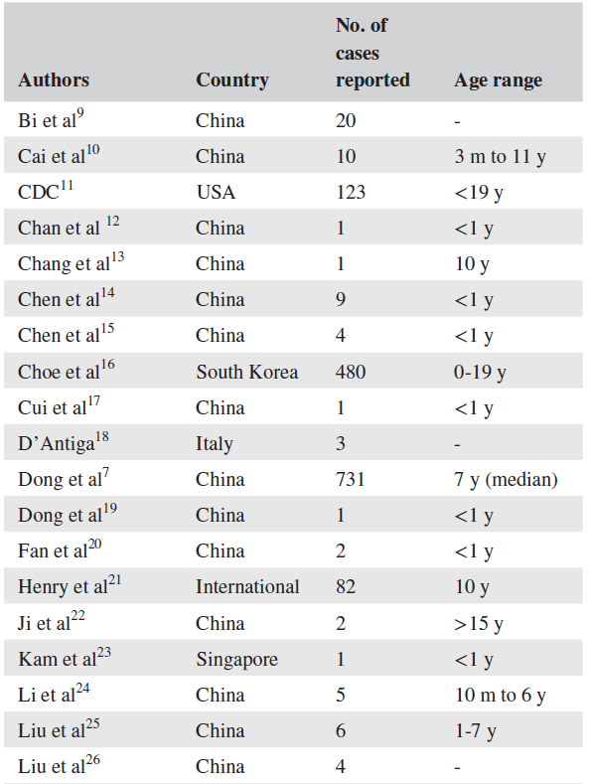
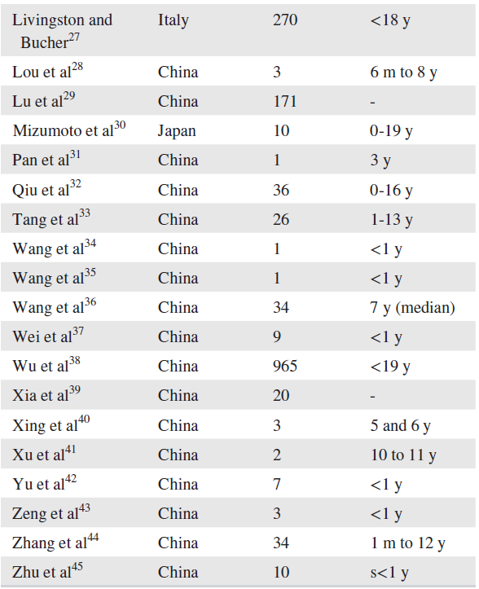
Summary of Paediatric cases reported with COVID-19
Notes:
These numbers are likely to be under-representative, as there is not universal testing of the whole population for the presence of COVID-19

Slide 7
The child patient in the dental setting
Transmitted through direct and indirect contact
Respiratory droplets and splatter from saliva and blood through contact with mucous membranes and contaminated fomites
Dental professionals in potentially high-risk situations
Aerosol Generating Procedures (AGPs), which have been associated with the transmission of acute respiratory infections
Dental chairs
Their handles
Spittoon
Dental instruments after treatment
Can persist on surfaces for up to 72 hours
Notes:
Because of the long incubation period (2-14 days)6 for everyone, and because children can be asymptomatic or present with mild, nonspecific symptoms, all child patients and parents should be considered as potential carriers of SARSCoV-2 unless proved otherwise.
and all clinic surfaces should be disinfected using chemicals recommended for eliminating SARS-CoV-2.

Slide 8
Universal precautions should be routinely followed in dental clinics.
They are critical for avoiding the transmission of SARS-CoV-2 virus to children as well as transmission from infected children to healthcare professionals.
Infection Prevention Checklist
Administrative measures
Infection prevention education and training
Dental healthcare personnel safety, programme evaluation
Hand hygiene, personal protective equipment (PPE)
Respiratory hygiene/cough etiquette
Sharps safety
Safe injection practices
Sterilization and disinfection of patient-care items and devices
Environmental infection prevention and control
Dental unit water quality.
Notes:
An infection prevention checklist should be used, including administrative measures, infection prevention education and training, dental healthcare personnel safety, programme evaluation, hand hygiene, personal protective equipment (PPE), respiratory hygiene/cough etiquette, sharps safety, safe injection practices, sterilization and disinfection of patient-care items and devices, environmental infection prevention and control, and dental unit water quality.

Slide 9
Country-specific approaches & recommendations
WHO - PANDEMIC - 6 different Phases
‘Widespread Human Infection’ phases
Dental practices remain open but there are screening activities and additional cross-infection measures
Contain the disease spread quite quickly as seen in Singapore, for example where isolation and testing were put in place within a very short space of the infection being suspected as being present in the country.
2. Closed all dental practices
Notes:
Countries will be in different phases at different times; therefore, it is not possible to give universal guidelines so following local updated guidelines are essential.
All the above applies to child patients during the acute phase of COVID-19 pandemic, and the treatment choices and planning may vary during the next phases
Countries have put different measures in place for the overall delivery of dental care even during the ‘Widespread Human Infection’ phases of the pandemic leading up to the peaks of infection

Slide 10
Dental practices remain open but there are screening activities and additional cross-infection measures
Contain the disease spread quite quickly as seen in Singapore, for example where isolation and testing were put in place within a very short space of the infection being suspected as being present in the country.
Closed all dental practices
Such as the UK, have all cases triaged by telephone and attending only for very basic treatment in designated centres
only emergency
and urgent dental care should be performed (from 20 March
2020), and all private offices have to stop elective treatments.
Dental professionals (primary and secondary care) that work
for the National Health Service (SUS)
In Brazil, The National Health Surveillance Agency (ANVISA)
Notes:
The clinical symptoms of COVID-19 are still being documented and collated, although the majority of affected patients exhibit symptoms including a dry cough which is usually accompanied by fever

Slide 11
The role of guidelines and professional judgment
Local
Regional
National guidelines
Notes:
Guidance cannot ever cover all possible circumstances, and professional judgement must be exercised to make decisions around whether or not to provide treatment
Treatment should only be provided adhering to local, regional, and national guidelines as far as possible and, in the opinion of the dental professional, when it is safe for child patients, their accompanying carer, and for the dental team.

Slide 12
CONCLUSIONS

Slide 13
RELATED ARTICLE -1
COVID-19 Disease in Children: What Dentists Should Know and Do to Prevent Viral Spread. The Italian Point of View
Ferrazzano GF, Ingenito A, Cantile T.
International Journal of Environmental Research and Public Health.
2020 Jan;17(10):3642.

Slide 14
2019 novel coronavirus (2019-nCoV)
11 Feb 2020, - International Committee on Taxonomy of Viruses - new coronavirus capable of infecting humans as SARS-CoV-2
World Health Organization declared disease caused by this virus as COVID-19

Slide 15
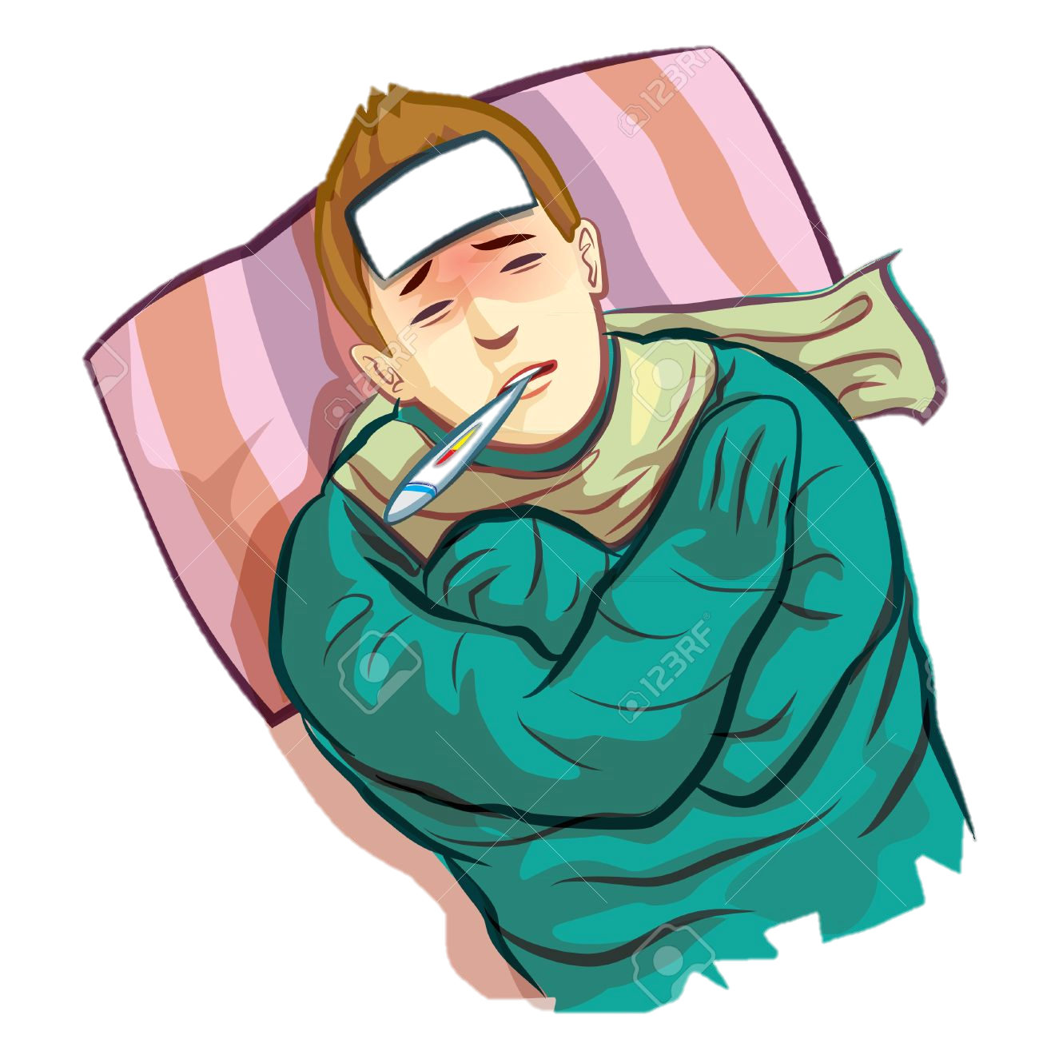


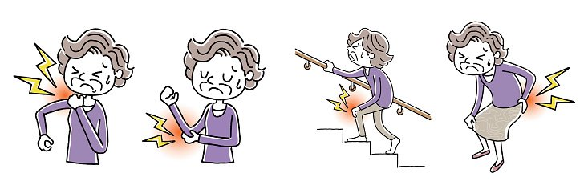
fever, Cough, shortness of breath or difficulty in breathing, tiredness, body aches, runny nose, sore throat.
Notes:
In adults,
signs and symptoms of COVID-19 may appear two to 14 days after exposure and can include: fever, ough, shortness of breath or diculty breathing, tiredness, body aches, runny nose, sore throat.

Slide 16
Severity - very mild to severe.
Complications - Pneumonia in both lungs
Organ failure in several organs & death

Slide 17
Lu et al.
Nasopharyngeal or throat swabs - 1391 children assessed
41.5%
fever
Cough & erythema
15.8%
No symptoms
12 patients
+ve Pneumonia radiographs
No symptoms
171 (12.3%) were confirmed
Dong et al
94 (4.4%)
Asymptomatic
1091 (50.9%)
Mild cases
831 (38.8%)
Moderate cases
2143 pediatric patients with COVID-19
Notes:
Fever was present in 41.5%
Cough & pharyngeal erythema
27 patients (15.8%) did not have any symptoms of infection or radiologic features of pneumonia.
12 patients had radiologic features of pneumonia
but did not have any symptoms of infection
A comprehensive study conducted by Dong et al. reported data on 2143 pediatric patients with COVID-19. Of them, 731 (34.1%) patients were identified as laboratory-confirmed cases and 1412 (65.9%) were suspected cases. For the severity of patients (including both confirmed and suspected cases), 94 (4.4%), 1091 (50.9%) and 831 (38.8%) patients were diagnosed as asymptomatic, mild or moderate cases, respectively, totally accounted for 94.1% of all cases [16].

Slide 18
The reason why COVID-19 cases in children are less severe than in adults is still confusing
Children having a more active innate immune response, healthier respiratory tracts because they have not been exposed to as much cigarette smoke and air pollution as adults, and less underlying illnesses
Weaker ability to trigger an acute inflammatory response to SARS-CoV-2 might also contribute to the children’s better outcome

